Slide 1
ELECTRIC POWER MARKET WITH INTERMITTENT GENERATION
By Ashish Upadhyay, Ayush Rathi, Yashvardhan JAin

Slide 2
Introduction
A combination of renewable and non-renewable sources is used for generation of electric power.
Power supplied by non- renewable sources varies immensely due to imperfections such as forecast errors, fluctuations errors etc.
Any Day Ahead (DA) planning needs to be balanced in real time (RT) to meet the demand of the system operator.
Smart grids in the current world market are designed with a combination of flexible and inflexible generators in order to account for any real time adjustment.

Slide 3
An optimal system needs to be designed that minimizes the cost as well as meets the required demand in real time ensuring the grid stability.
Scheduling and dispatching based on DA demand varies from the RT requirement.
Renewable sources like wind and solar have output levels for different probabilities out of which only one scenario realizes in RT.
On the basis of the DA and RT computations, a system is designed that provides an optimal solution with the appropriate ratio between renewable and non-renewable sources.
Expand more.

Slide 4

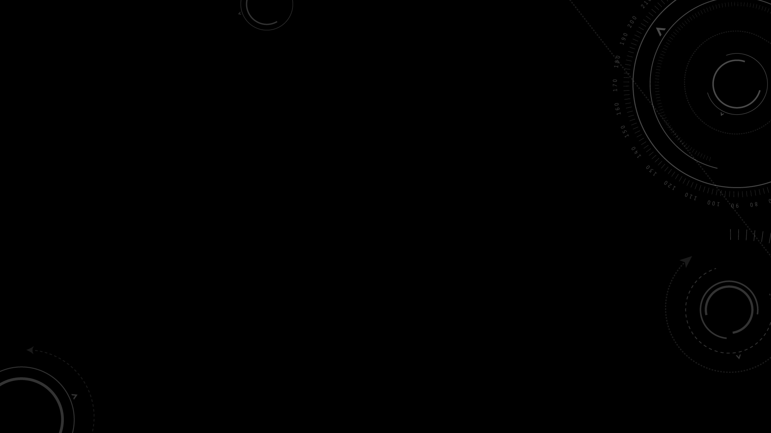

First and foremost to get an A!
For in depth understanding of the current electric grid system along with its economic aspects.
Impact of renewable and conventional generators on the market intrigued us.
People assume that sources such as wind farms are free of cost other than the investment but there are several other cost associated with them that increase the total system price.

Slide 5
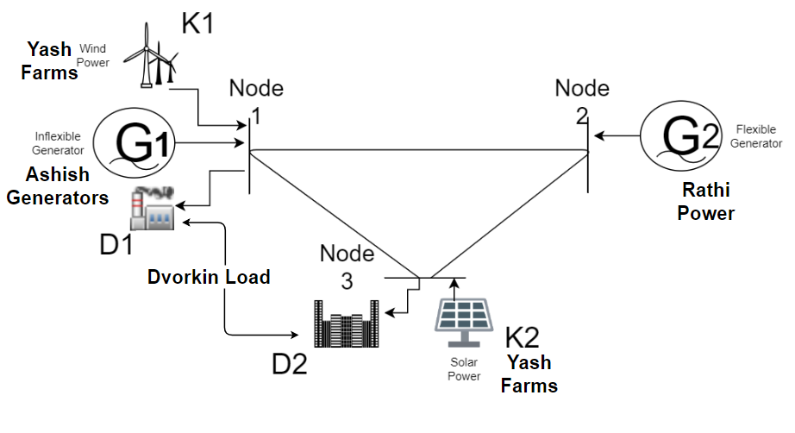
Model Presented
A three-node network has been designed for the analysis of an electric grid with multiple loads and generation units.
Power generation units are assumed to be flexible and inflexible along with unpredictable units in the form of wind and solar power plants.
The organization of the supply and demand is as shown in the figure.

Slide 6

Generator G1 and G2 are scheduled in DA with G2 acting as the flexible generator.
Wind and solar power are scheduled in DA using the weighted average method.
$$Weighted Average=\sum_{i=1}^{n}{P\left(i\right)∗Power Expected(i)}$$
Where C(i) is cost of Pgen(i) generation
5 scenarios are taken from s1*s5 each having equal probability (0.2) of realization under real time (RT).
Market clearing optimization problem is simulated, maintaining the dual variable constraints along with generation and line limits.

Slide 7

The cost function designed is given as follows :
$$System cost,RT=\sum{P\left(i\right)∗[C\left(i\right)∗RT adjustment ]}$$
Where P(i) is probability of renewable scenarios, RT adjustment is adjustment of flexible generator to compensate for i^{th} scenario, C(i) is cost of i^{th} generator.
We are also considering the cost of lost load in RT and the cost in of spillage in RT.
$$\sum{VOLL\left(i\right)∗Pshed(i)}$$
Where VOLL(i) is value of lost load and P_{shed} (i) is power shed in i^{th} scenario.
$$Spillage Cost= \sum{P\left(i\right)∗Power Spill\left(k, s\right)∗Penality}$$
Where P(i) is probabilistic scenario and Power Spill (k, s) is power Spilled by k^{th} renewable unit in i^{th} scenario and penalty is penalty cost associated with spillage.

Slide 8
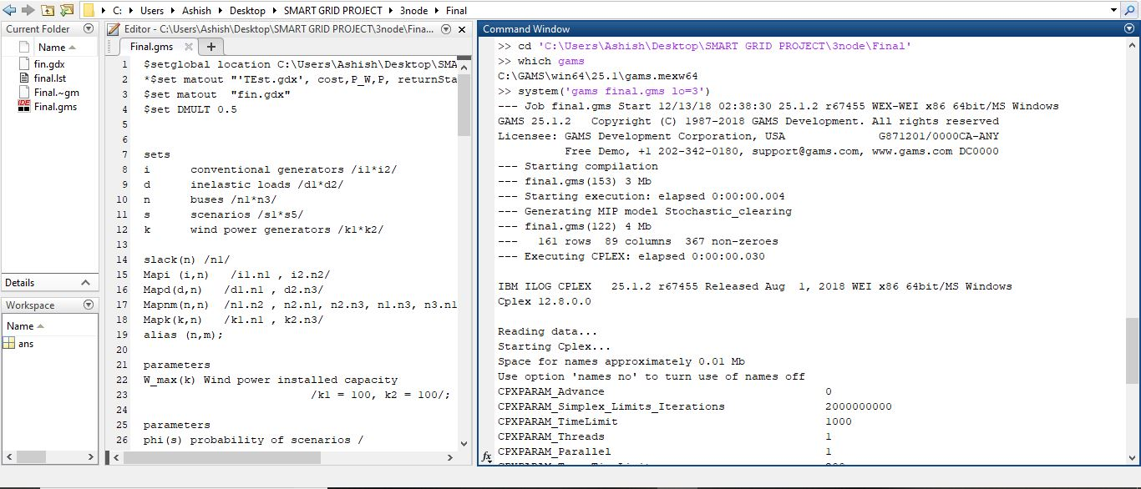
Execution of GAMS in MATLAB

Slide 9

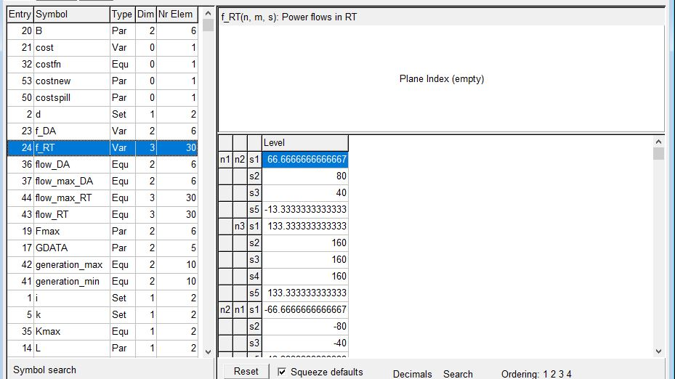
GDX ( Gams Data eXchange ) output file

Slide 10
Case study
80-20:
- 80% of the load is supplied by the conventional generators and 20% is supplied by solar/wind.
- The simulation yields a result with a system cost of $23640.
- There is no spillage in this case as the flexible generator can cover for all possible real time
realizations of wind/solar power.
- Hence the total system cost remains the same. The scenario specs are given below;
Generation/Scenario | S1 | S2 | S3 | S4 | S5
K1 | 100 | 90 | 80 | 70 | 60
K2 | 100 | 90 | 80 | 70 | 60
Weighted Average |  | 160 MW

Slide 11
II. 50-50:
- The required demand is spilt evenly between
the renewable and non-renewable generators.
- Upon realization the system cost is computed
to be $16086.
- The spillage cost computed for this case is $50.
- The final system cost that includes the spillage
cost turns out to be $16136
III. 20-80:
- 20% of the load is supplied by the conventional
generators and 80% is supplied by solar/wind.
- As the data suggests, the system cost without
considering any spillage adds to $11160.
- However the system cost with spillage amounts
to $11240.
- The spillage cost as per this scenario is $80.
Generation/Scenario | S1 | S2 | S3 | S4 | S5
K1 | 250 | 225 | 200 | 175 | 150
K2 | 200 | 225 | 200 | 175 | 150
Weighted Average |  |  | 400
Generation/Scenario | S1 | S2 | S3 | S4 | S5
K1 | 400 | 360 | 320 | 280 | 240
K2 | 400 | 360 | 320 | 280 | 240
Weighted Average |  |  | 320

Slide 12
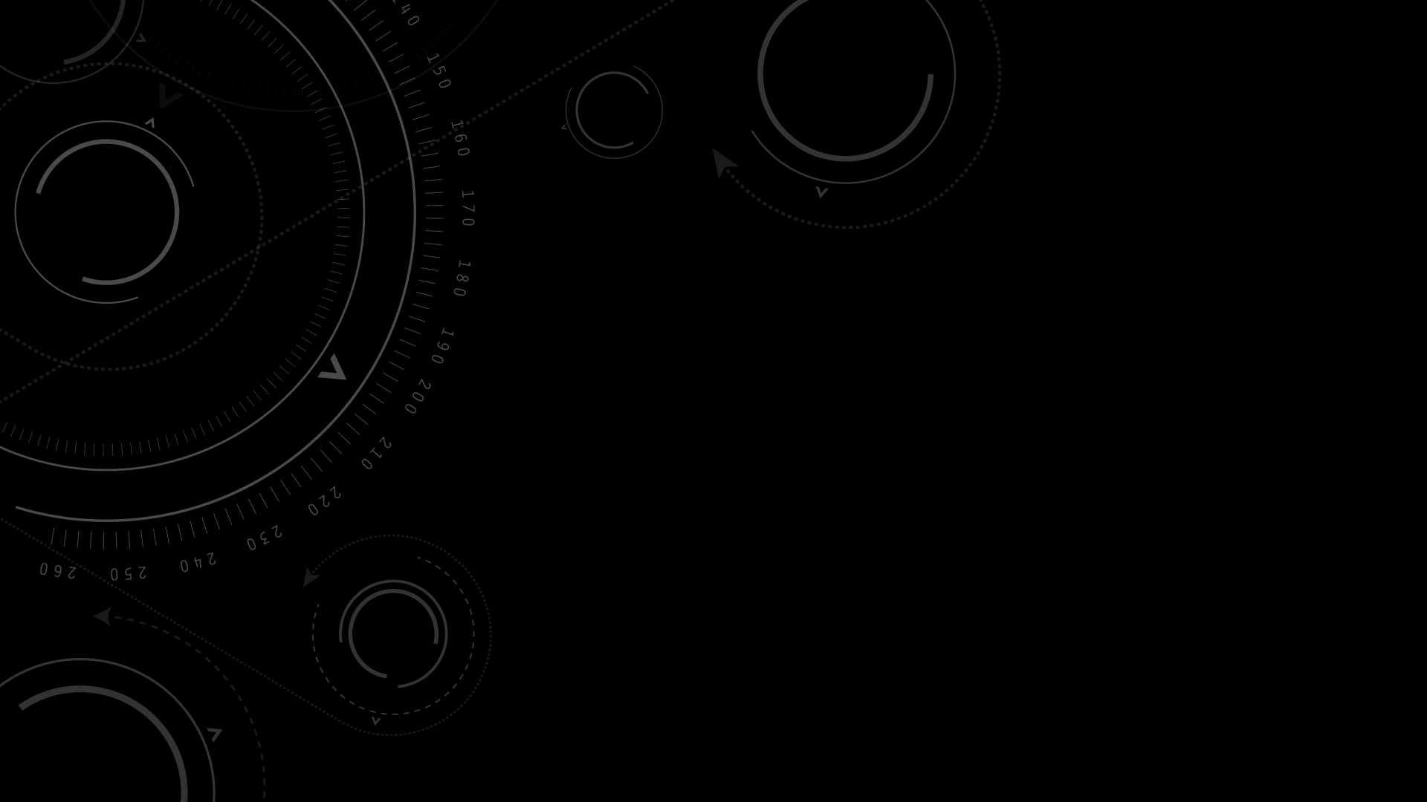
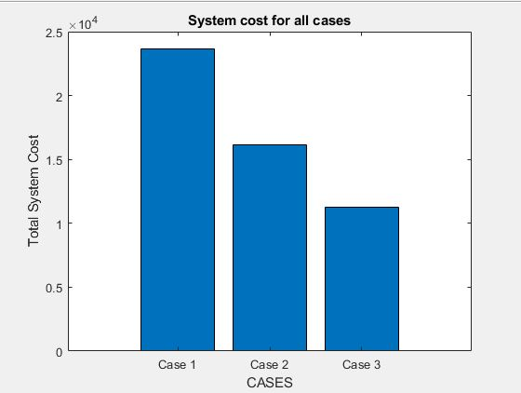
Total System Cost

Slide 13
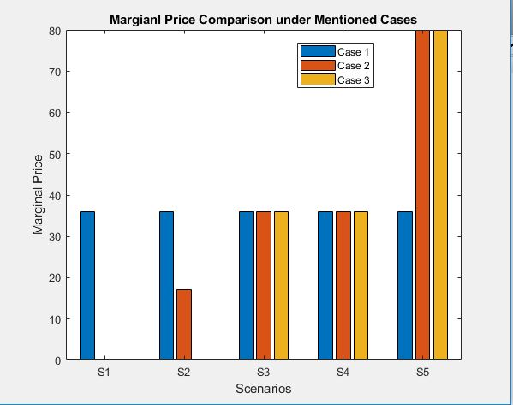
Locational marginal price (LMP) comparison for scenarios s1-s5

Slide 14

Analysis of the multi-staged problem designed revealed:
1) With negligible cost of generation, renewable sources may impose additional cost on
the grid in the form of spillage cost.
2) Transmission line constraints cause a deviation in the locational marginal price at
each node.
3) All results are computed in real time using weighted average even for spillage to
arrive at the near accurate system cost.
4) Flexibility of the generators can be increased in order to bring down system
operators’ cost.

Slide 15


